Slide 1
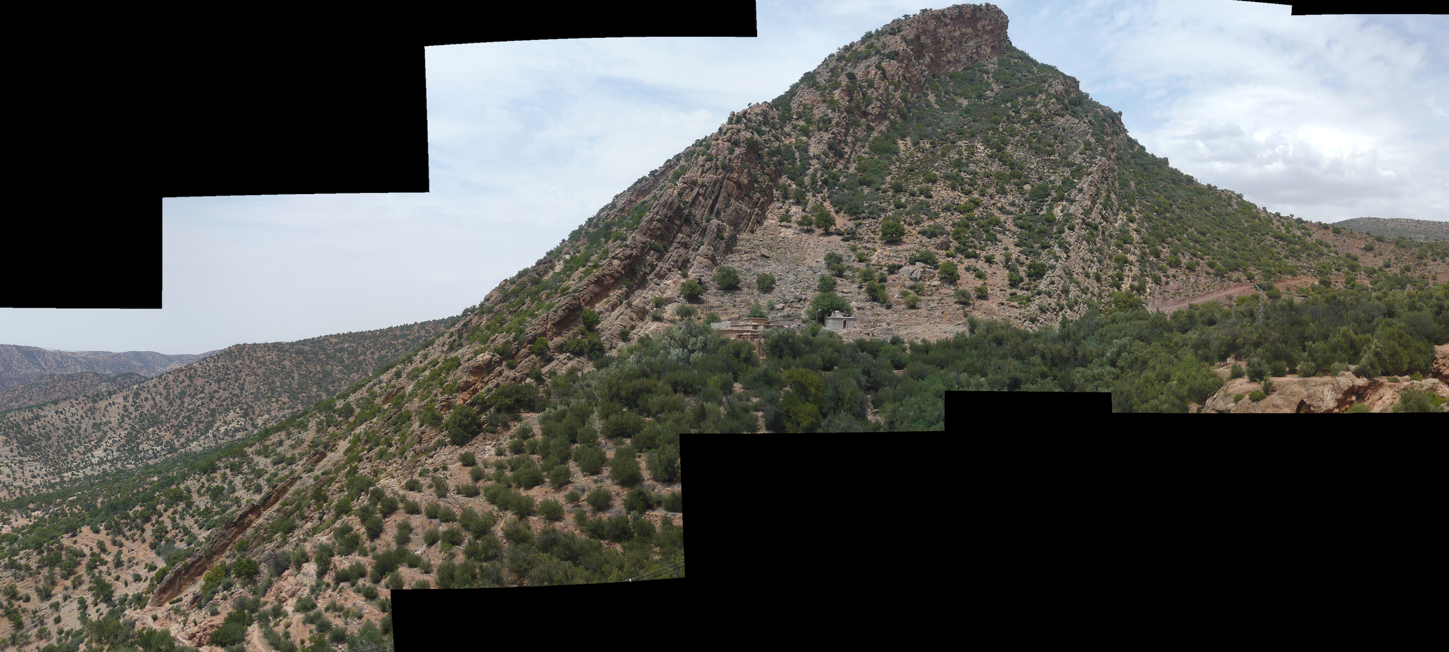
Outcrop overview
Marl member

Slide 2
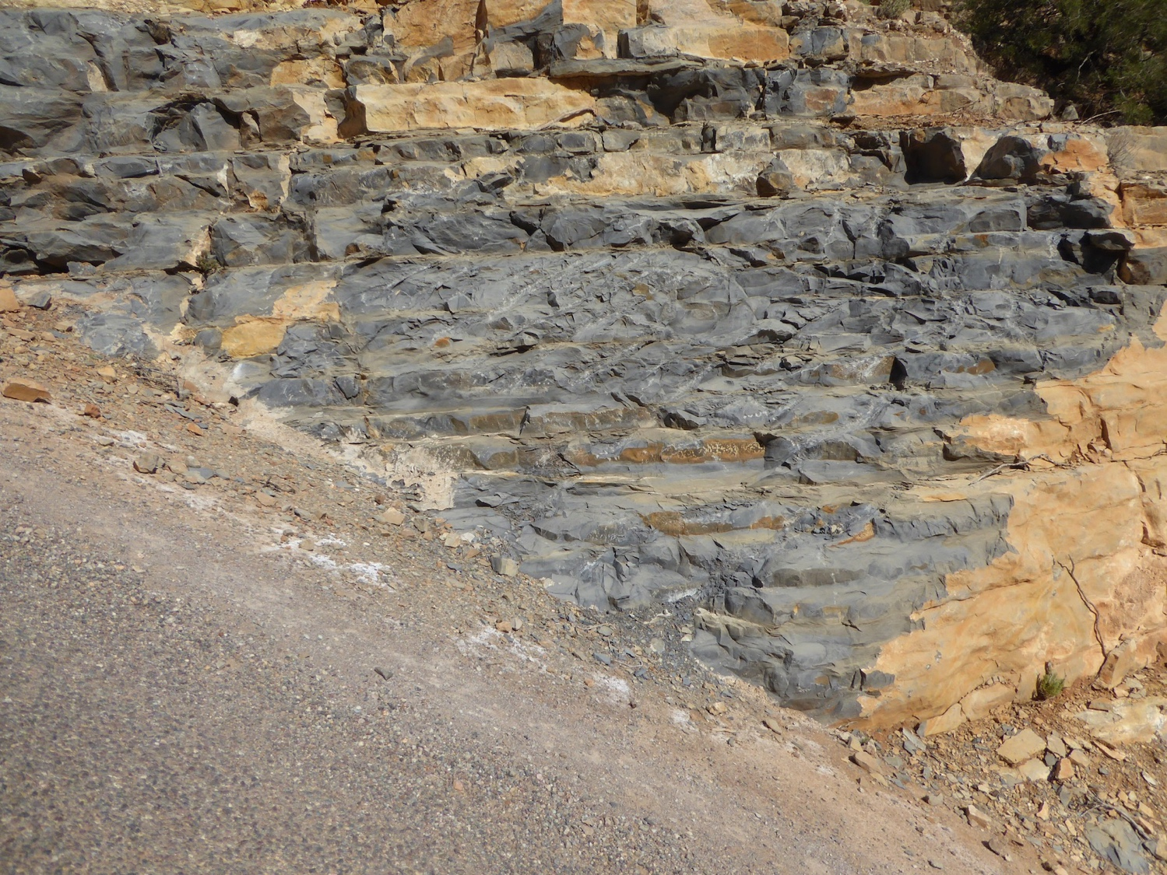
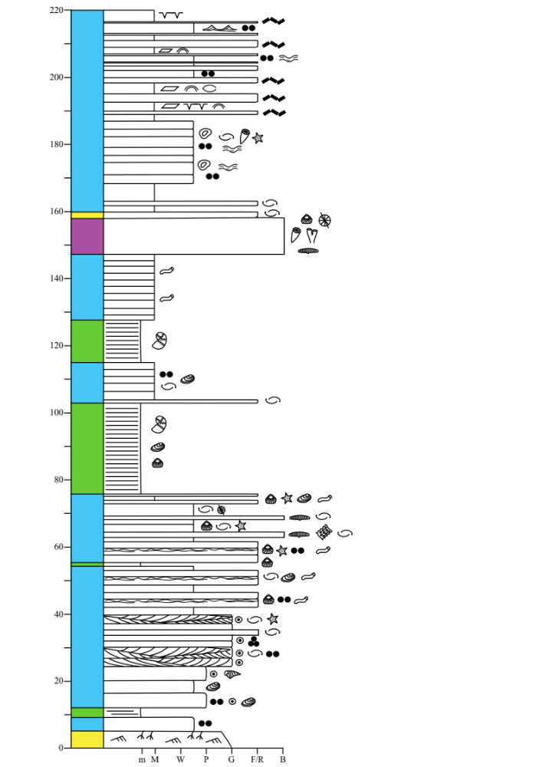
Unit 3a: Marl member
Outcrop appearance (HS)
(3.7)
Towards the top of the marl member, limestone beds become dark grey and have a distinct kerogen smell when hitting with a hammer.
What gives these limestones the dark color?

Slide 3
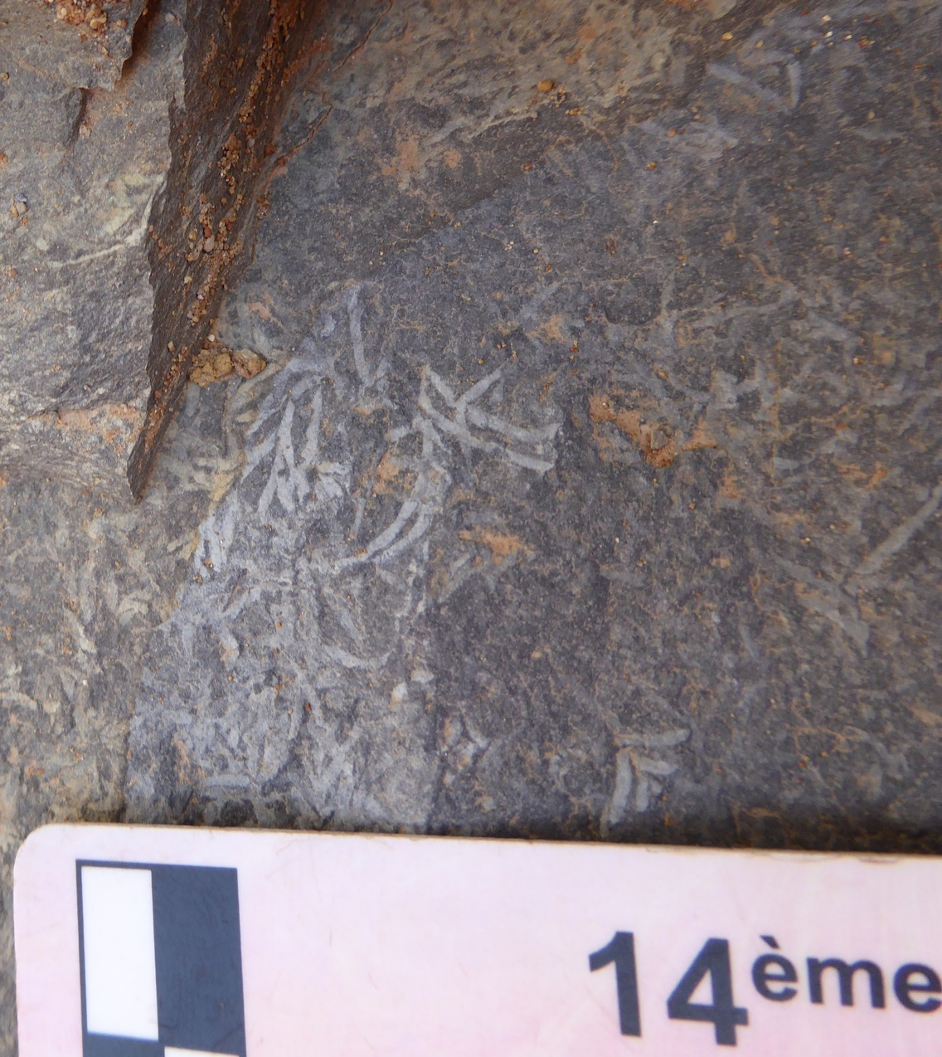
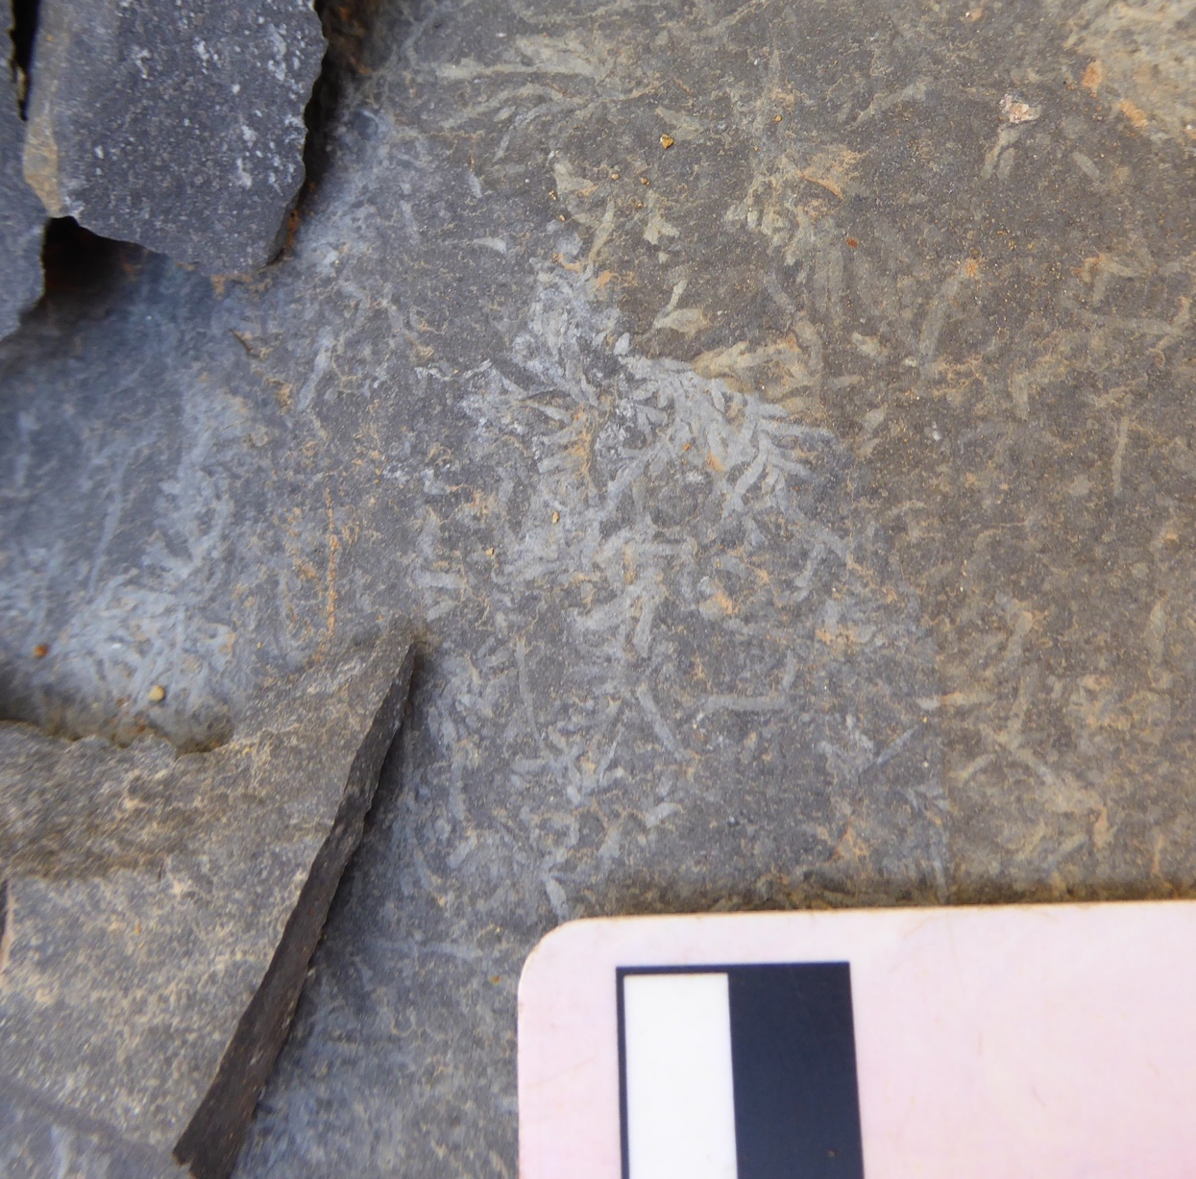
Unit 3: Marl member
Outcrop appearance (HS)
(3.8)
(3.9)
Limestones are devoid of fossils, but bedding surfaces contain this structure – what is it, and what does it tell us about the environment of deposition?

